Slide 1

FPT EDUCATION
Architecture of ESP8266 development board
Version 1.0

Slide 2
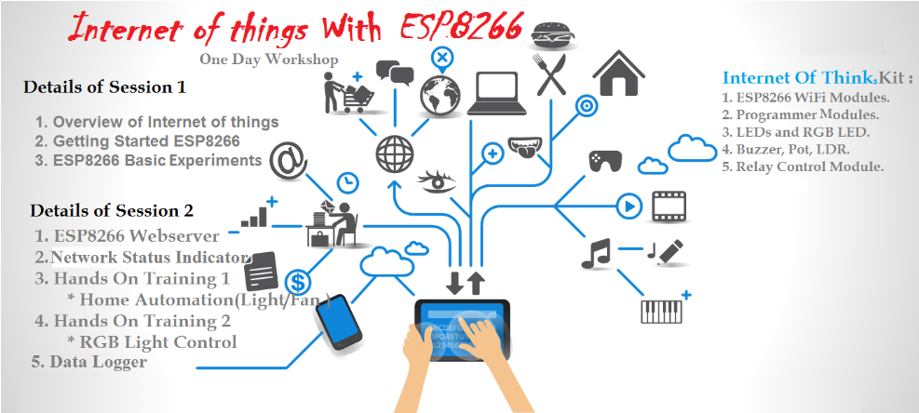
IOT WITH ESP8266

Slide 3
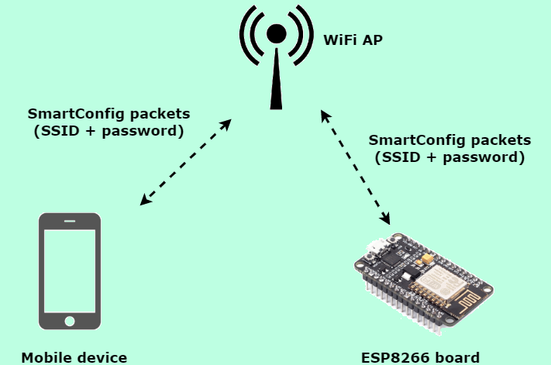
IOT WITH ESP8266

Slide 4
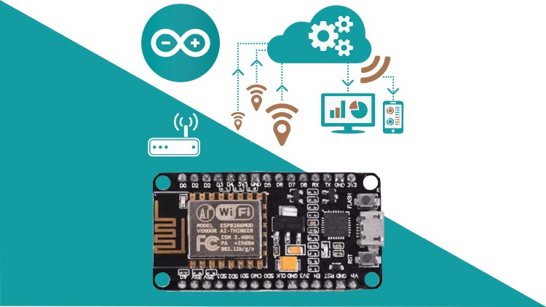
IOT WITH ESP8266

Slide 5
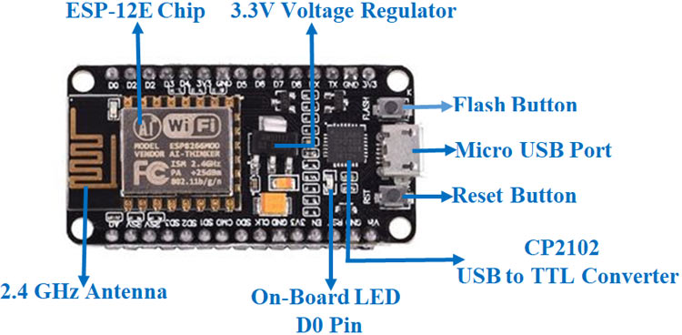
What is ESP8266?

Slide 6
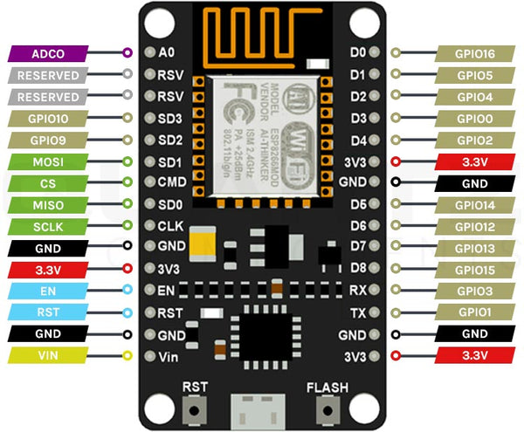
What is ESP8266?

Slide 7
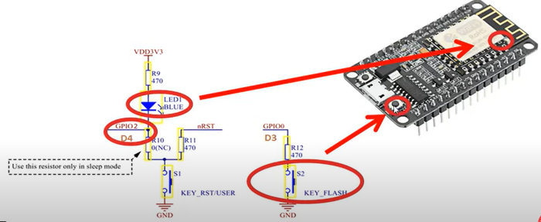
What is ESP8266?

Slide 8
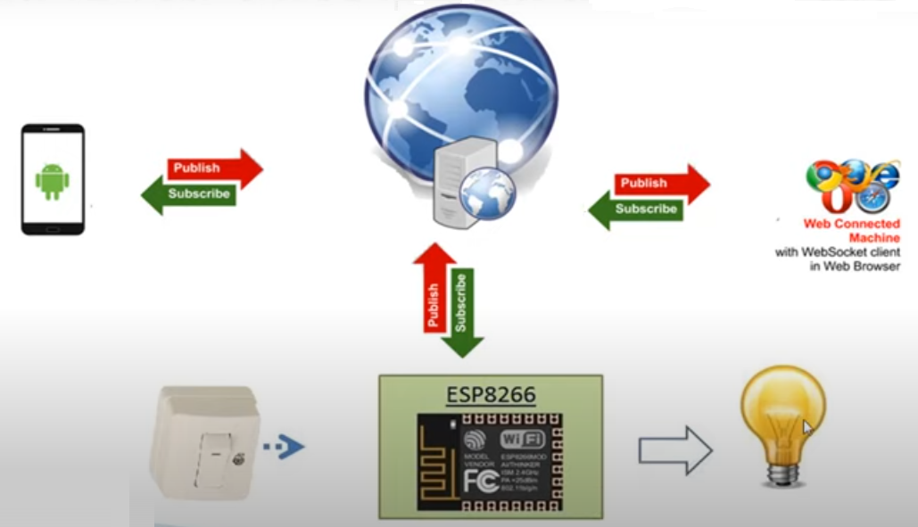
What can ESP8266 do?
1

Slide 9
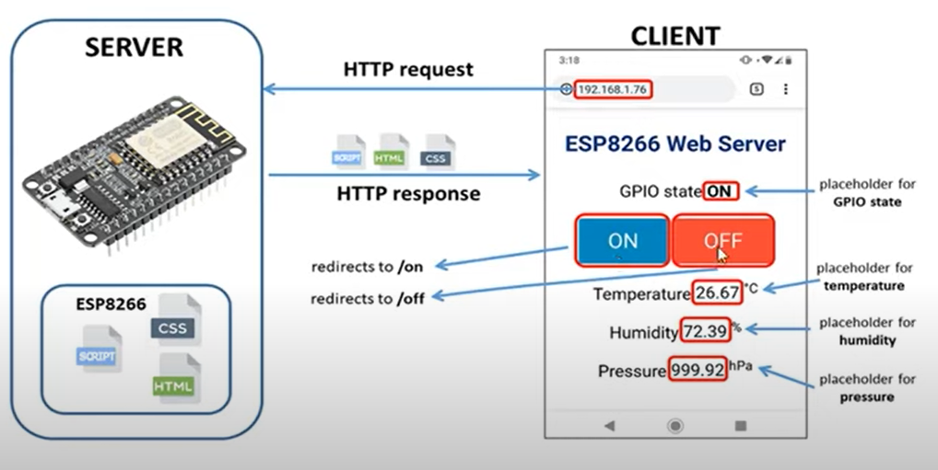
What can ESP8266 do?

Slide 10
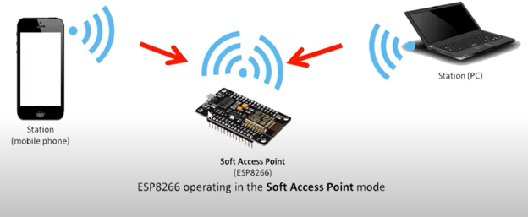
What can ESP8266 do?
Access Point Mode

Slide 11
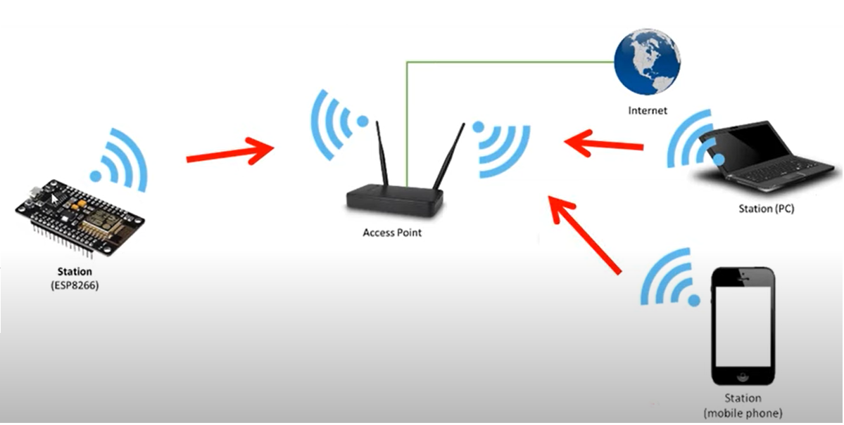
What can ESP8266 do?
Station Mode

Slide 12
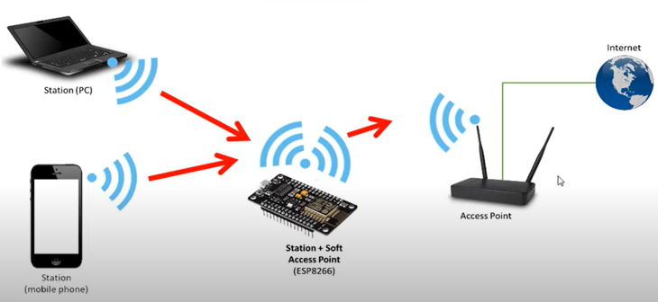
What can ESP8266 do?
Station and Access Point Mode

Slide 13
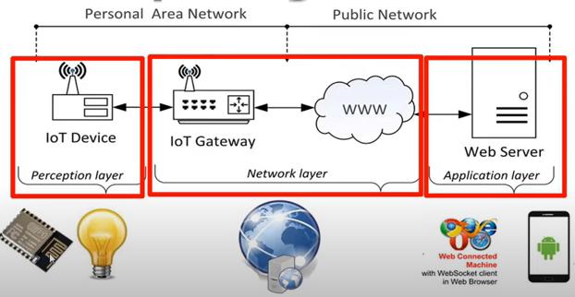
What can ESP8266 do?
Basic IOT model with ESP8266

Slide 14
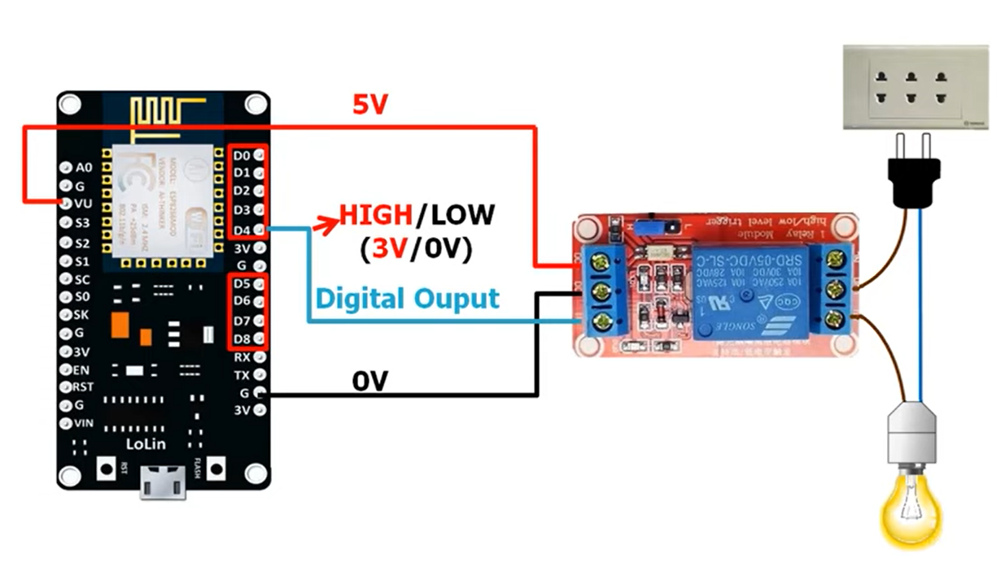
On/Off Device Local
1

Slide 15
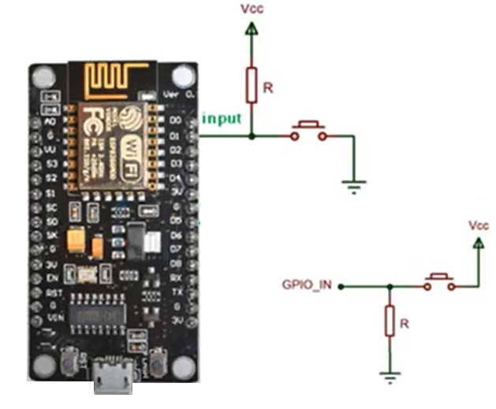
INPUT

Slide 16
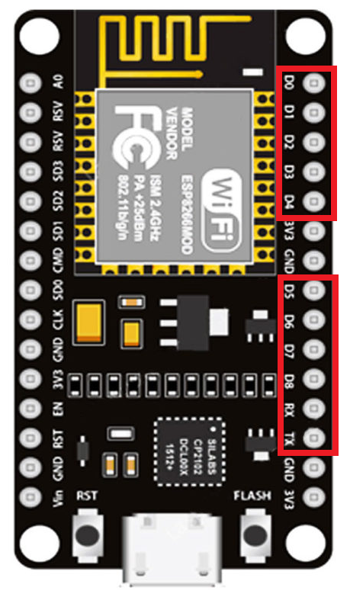
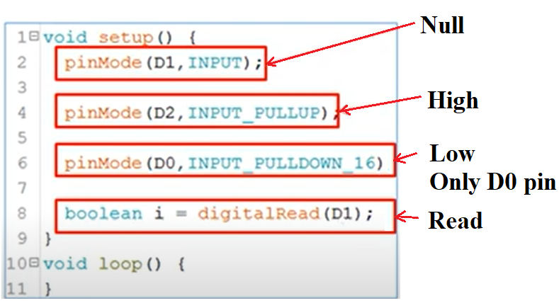
INPUT

Slide 17
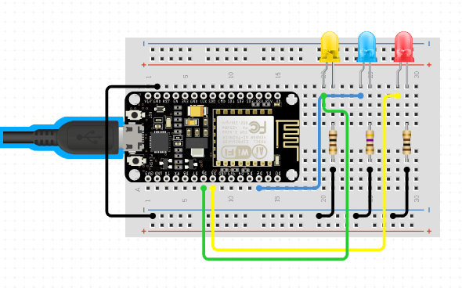
OUTPUT

Slide 18
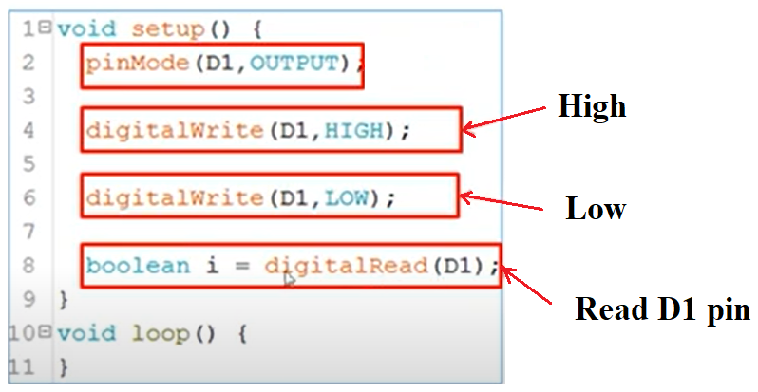
OUTPUT

Slide 19
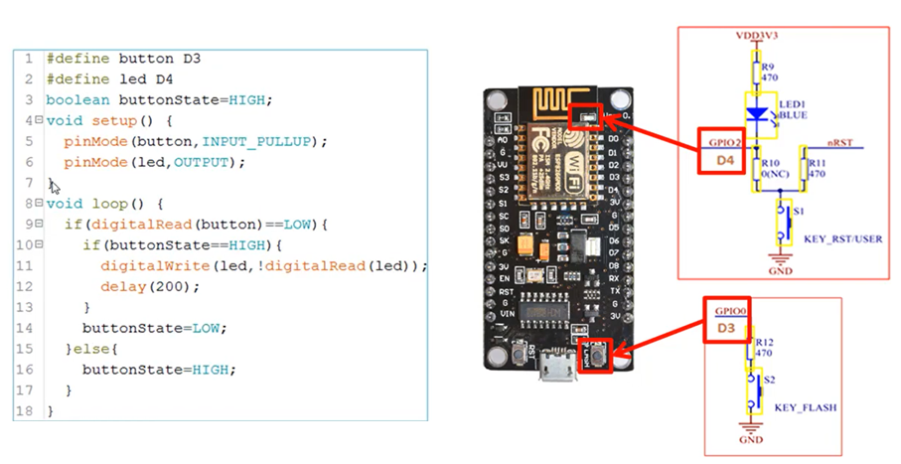
On/Off Device Local

Slide 20
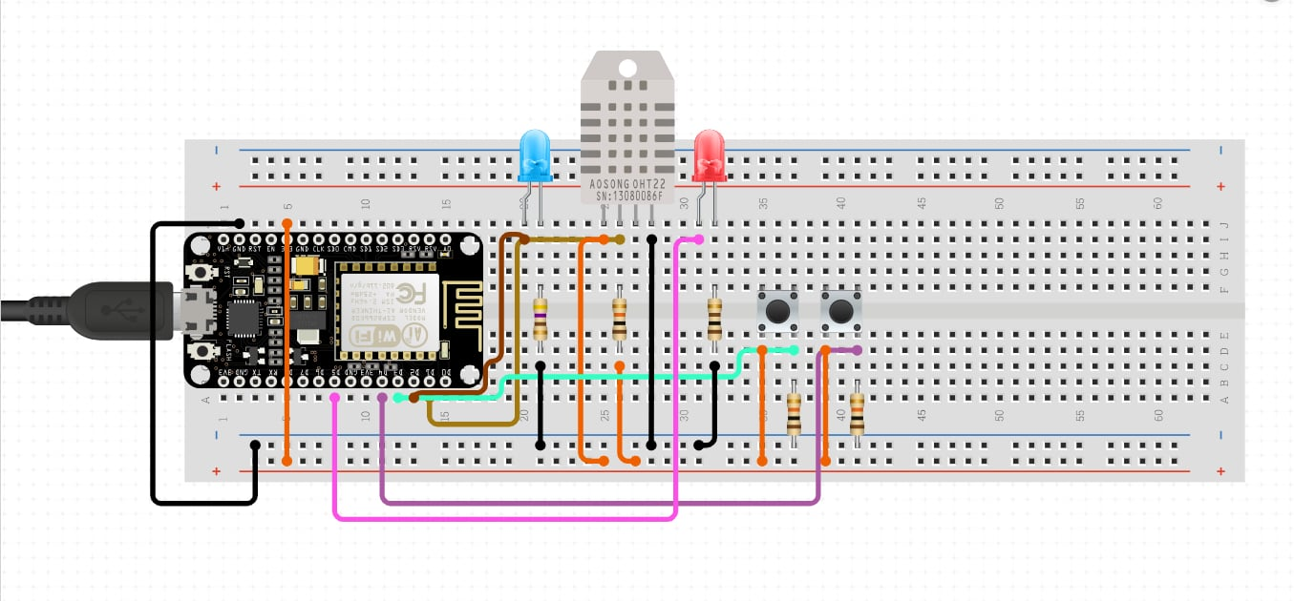
On/Off Device Local

Slide 21
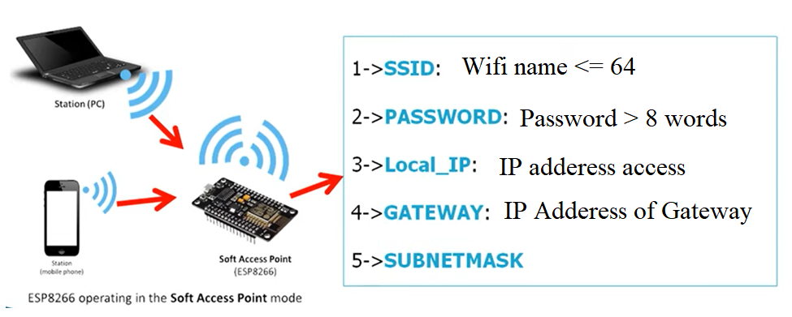
Access Point Mode

Slide 22
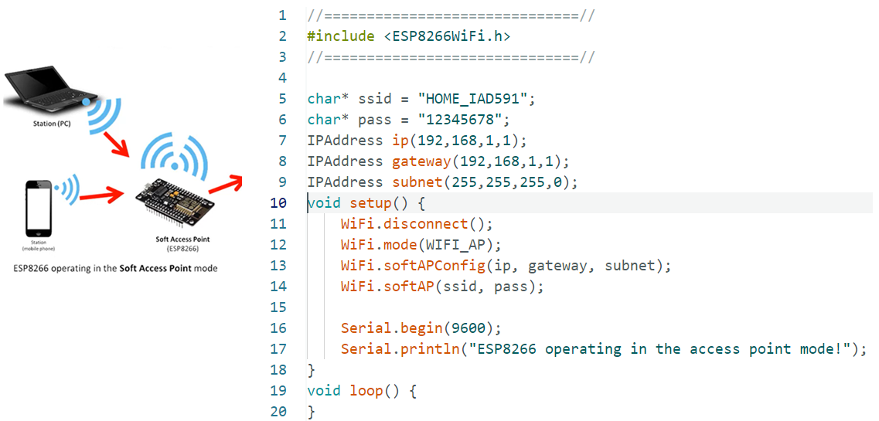
Access Point Mode

Slide 23
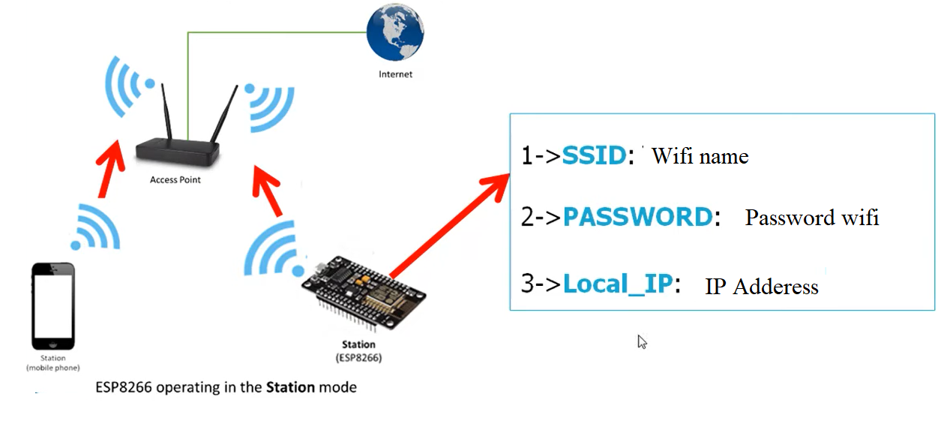
Station Mode

Slide 24
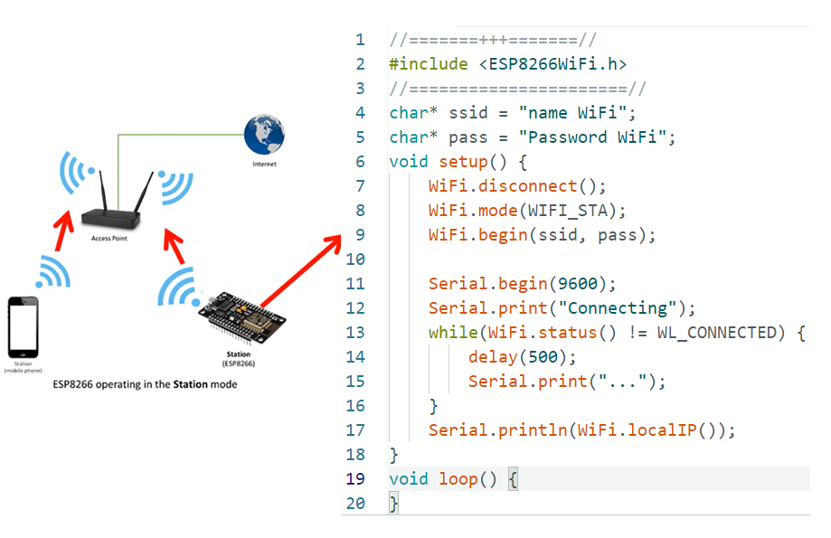
Station Mode

Slide 25
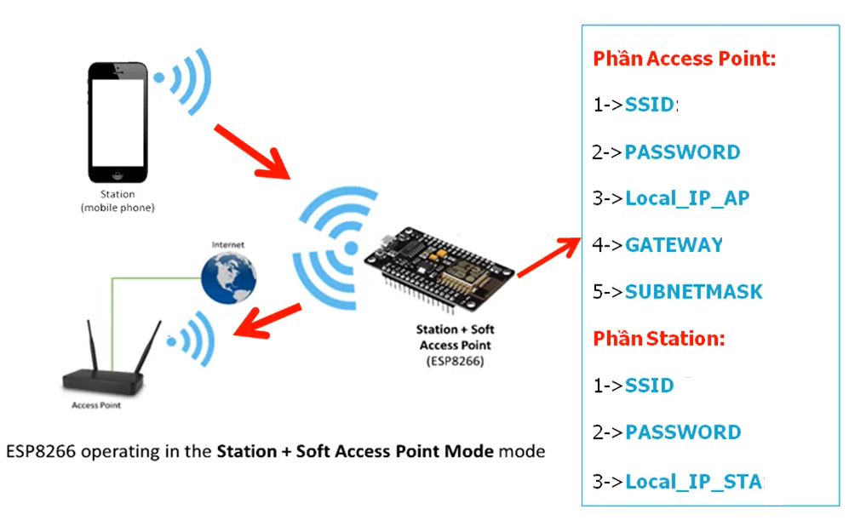
Station and Access Point Mode

Slide 26
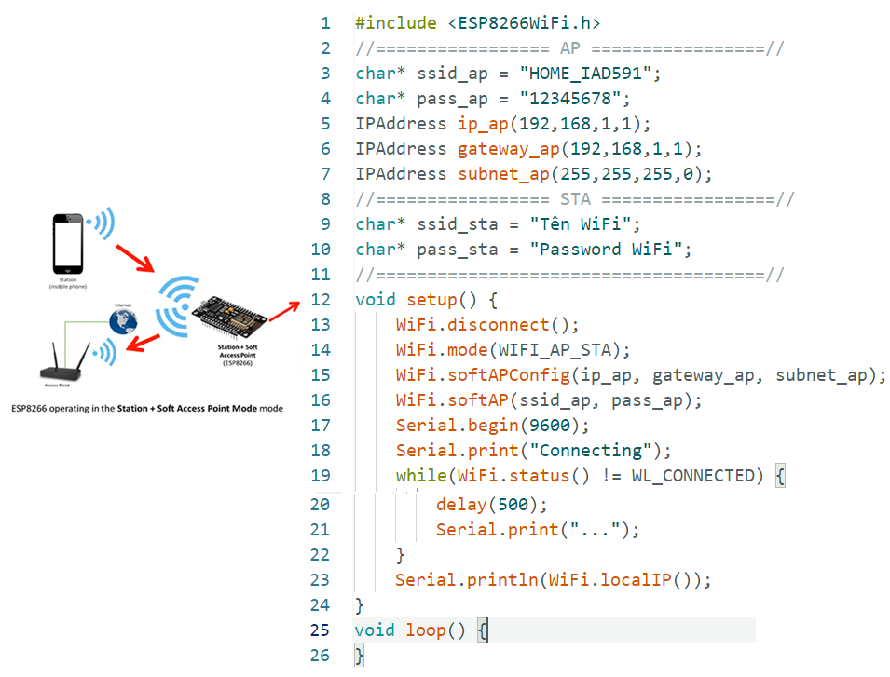
Station and Access Point Mode

Slide 27

Webserver
https://www.youtube.com/watch?v=aoWAltuGFMg&t=0s
Notes:
Giới thiệu về Webserver: https://www.youtube.com/watch?v=LdbqrYT7Q0g&t=631s
Tạo Webserver: https://www.youtube.com/watch?v=aoWAltuGFMg&t=0s

Slide 28
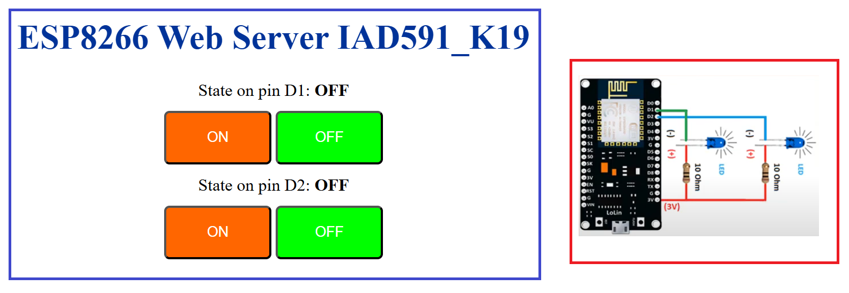
Webserver
Notes:
Code 1: Điều khiển thiết bị qua Server Web
#include <ESP8266WiFi.h>
#include <ESP8266WebServer.h>
ESP8266WebServer webServer(80);
char* ssid = "Tên WiFi";
char* pass = "Password WiFi";
//=========Biến chứa mã HTLM Website==//
const char MainPage[] PROGMEM = R"=====(
<!DOCTYPE html>
<html>
<head>
<title>HOME PAGE</title>
<style>
body {text-align:center;}
h1 {color:#003399;}
a {text-decoration: none;color:#FFFFFF;}
.bt_on {height:50px; width:100px; margin:10px 0;background-color:#FF6600;border-radius:5px;}
.bt_off {height:50px; width:100px; margin:10px 0;background-color:#00FF00;border-radius:5px;}
</style>
<meta charset="UTF-8">
</head>
<body>
<h1>ESP8266 Web Server</h1>
<div>Trạng thái trên chân D1: <b>OFF</b></div>
<div>
<button class="bt_on"><a href="/onD1">ON</a></button>
<button class="bt_off"><a href="/offD1">OFF</a></button>
</div>
<div>Trạng thái trên chân D2: <b>OFF</b></div>
<div>
<button class="bt_on"><a href="/onD2">ON</a></button>
<button class="bt_off"><a href="/offD2">OFF</a></button>
</div>
</body>
</html>
)=====";
//=========================================//
void setup() {
pinMode(D1,OUTPUT);
pinMode(D2,OUTPUT);
digitalWrite(D1,HIGH);
digitalWrite(D2,HIGH);
WiFi.begin(ssid,pass);
Serial.begin(9600);
Serial.print("Connecting");
while(WiFi.status()!=WL_CONNECTED){
delay(500);
Serial.print("...");
}
Serial.println(WiFi.localIP());
webServer.on("/",mainpage);
webServer.on("/onD1",on_D1);
webServer.on("/offD1",off_D1);
webServer.on("/onD2",on_D2);
webServer.on("/offD2",off_D2);
webServer.begin();
}
void loop() {
webServer.handleClient();
}
//==========Chương trình con=================//
void mainpage(){
String s = FPSTR(MainPage);
webServer.send(200,"text/html",s);
}
void on_D1(){
digitalWrite(D1,LOW);
String s = FPSTR(MainPage);
webServer.send(200,"text/html",s);
}
void off_D1(){
digitalWrite(D1,HIGH);
String s = FPSTR(MainPage);
webServer.send(200,"text/html",s);
}
void on_D2(){
digitalWrite(D2,LOW);
String s = FPSTR(MainPage);
webServer.send(200,"text/html",s);
}
void off_D2(){
digitalWrite(D2,HIGH);
String s = FPSTR(MainPage);
webServer.send(200,"text/html",s);
}
Code 2: Cập nhật trạng thái ON/OFF trên Web
#include <ESP8266WiFi.h>
#include <ESP8266WebServer.h>
ESP8266WebServer webServer(80);
char* ssid = "Tên Wifi";
char* pass = "Mật khẩu";
//=========Biến chứa mã HTLM Website==//
const char MainPage[] PROGMEM = R"=====(
<!DOCTYPE html>
<html>
<head>
<title>HOME PAGE</title>
<style>
body {text-align:center;}
h1 {color:#003399;}
a {text-decoration: none;color:#FFFFFF;}
.bt_on {height:50px; width:100px; margin:10px 0;background-color:#FF6600;border-radius:5px;}
.bt_off {height:50px; width:100px; margin:10px 0;background-color:#00FF00;border-radius:5px;}
</style>
<meta charset="UTF-8">
</head>
<body>
<h1>ESP8266 Web Server</h1>
<div>Trạng thái trên chân D1: <b><pan id="trangthaiD1"><pan></b></div>
<div>
<button class="bt_on" onclick="getdata('onD1')">ON</button>
<button class="bt_off" onclick="getdata('offD1')">OFF</button>
</div>
<div>Trạng thái trên chân D2: <b><pan id="trangthaiD2"><pan></b></div>
<div>
<button class="bt_on" onclick="getdata('onD2')">ON</button>
<button class="bt_off" onclick="getdata('offD2')">OFF</button>
</div>
<div id="reponsetext"></div>
<script>
//-----------Tạo đối tượng request----------------
function create_obj(){
td = navigator.appName;
if(td == "Microsoft Internet Explorer"){
obj = new ActiveXObject("Microsoft.XMLHTTP");
}else{
obj = new XMLHttpRequest();
}
return obj;
}
var xhttp = create_obj();
//-----------Thiết lập dữ liệu và gửi request-------
function getdata(url){
xhttp.open("GET","/"+url,true);
xhttp.onreadystatechange = process;//nhận reponse
xhttp.send();
}
//-----------Kiểm tra response--------------------
function process(){
if(xhttp.readyState == 4 && xhttp.status == 200){
//------Updat data sử dụng javascript----------
ketqua = xhttp.responseText;
document.getElementById("reponsetext").innerHTML=ketqua;
}
}
//------------Kiểm tra trạng thái chân D1 D2------
function getstatusD1D2(){
xhttp.open("GET","getstatusD1D2",true);
xhttp.onreadystatechange = process_json;
xhttp.send();
}
//-----------Kiểm tra response-------------------------------
function process_json(){
if(xhttp.readyState == 4 && xhttp.status == 200){
//------Update data sử dụng javascript-------------------
var trangthaiD1D2_JSON = xhttp.responseText;
var Obj = JSON.parse(trangthaiD1D2_JSON);
document.getElementById("trangthaiD1").innerHTML = Obj.D1;
document.getElementById("trangthaiD2").innerHTML = Obj.D2;
}
}
//---Ham update duu lieu tu dong---
setInterval(function() {
getstatusD1D2();
}, 1000);
</script>
</body>
</html>
)=====";
//=========================================//
void setup() {
pinMode(D1,OUTPUT);
pinMode(D2,OUTPUT);
digitalWrite(D1,HIGH);
digitalWrite(D2,HIGH);
WiFi.begin(ssid,pass);
Serial.begin(9600);
Serial.print("Connecting");
while(WiFi.status()!=WL_CONNECTED){
delay(500);
Serial.print("...");
}
Serial.println(WiFi.localIP());
webServer.on("/",mainpage);
webServer.on("/onD1",on_D1);
webServer.on("/offD1",off_D1);
webServer.on("/onD2",on_D2);
webServer.on("/offD2",off_D2);
webServer.on("/getstatusD1D2",get_statusD1D2);
webServer.begin();
}
void loop() {
webServer.handleClient();
}
//==========Chương trình con=================//
void mainpage(){
String s = FPSTR(MainPage);
webServer.send(200,"text/html",s);
}
void on_D1(){
digitalWrite(D1,LOW);
webServer.send(200,"text/html","CHÂN D1 ĐÃ ON");
}
void off_D1(){
digitalWrite(D1,HIGH);
webServer.send(200,"text/html","CHÂN D1 ĐÃ OFF");
}
void on_D2(){
digitalWrite(D2,LOW);
webServer.send(200,"text/html","CHÂN D2 ĐÃ ON");
}
void off_D2(){
digitalWrite(D2,HIGH);
webServer.send(200,"text/html","CHÂN D2 ĐÃ OFF");
}
void get_statusD1D2(){
String d1,d2;
if(digitalRead(D1)==1){
d1 = "OFF";
}else{
d1 = "ON";
}
if(digitalRead(D2)==1){
d2 = "OFF";
}else{
d2 = "ON";
}
String s = "{\"D1\": \""+ d1 +"\",\"D2\": \""+ d2 +"\"}";
webServer.send(200,"application/json",s);
}

Slide 29
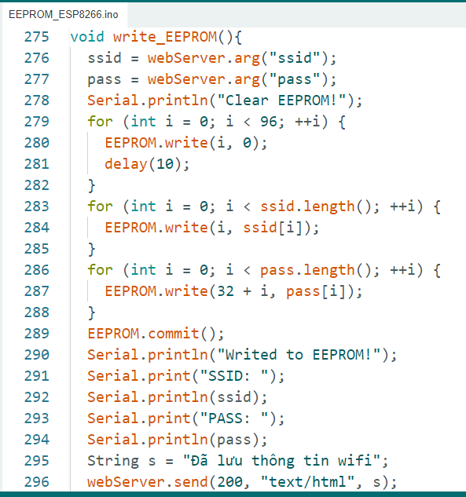
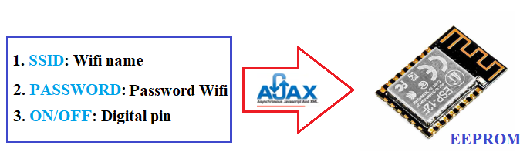
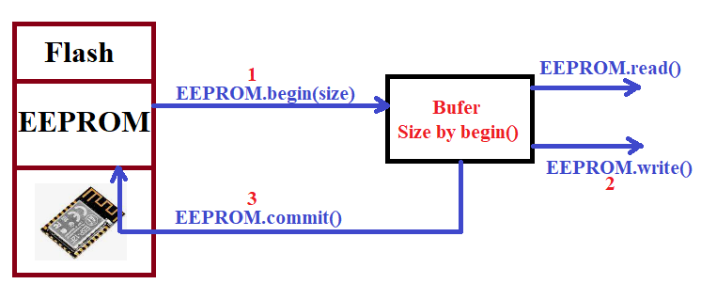
EEPROM
https://www.youtube.com/watch?v=aoWAltuGFMg&t=0s
WRITE EEPROM

Slide 30
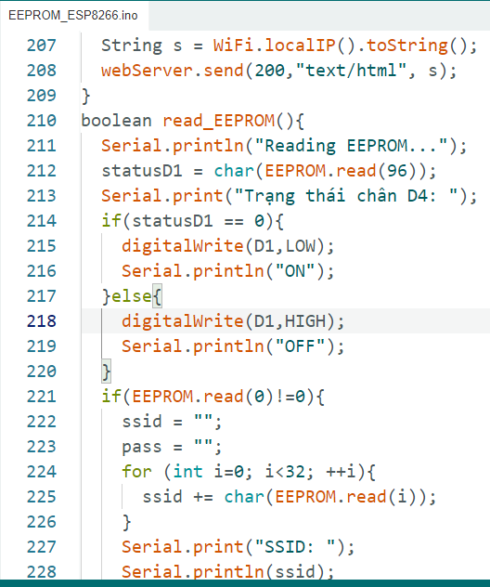
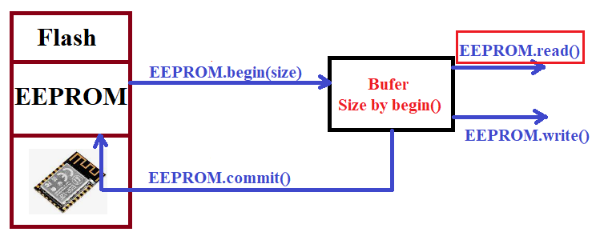
EEPROM
https://www.youtube.com/watch?v=aoWAltuGFMg&t=0s
READ EEPROM
Notes:
Quá trình đọcdữ liệu từ EEPROM chỉ cần dung câu lệnh EEPROM.read() là đủ

Slide 31
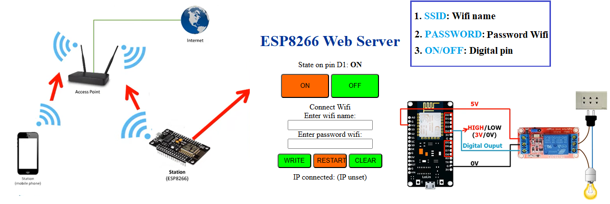
EEPROM
https://www.youtube.com/watch?v=aoWAltuGFMg&t=0s
Notes:
#include <ESP8266WiFi.h>
#include <ESP8266WebServer.h>
#include <EEPROM.h>
ESP8266WebServer webServer(80);
//==========AP info=======================//
char* ssid_ap = "HOME_IAD591";
char* pass_ap = "12345678";
IPAddress ip_ap(192,168,1,1);
IPAddress gateway_ap(192,168,1,1);
IPAddress subnet_ap(255,255,255,0);
String ssid;
String pass;
boolean statusD1;
//=========Biến chứa mã HTLM Website==//
const char MainPage[] PROGMEM = R"=====(
<!DOCTYPE html>
<html>
<head>
<title>HOME PAGE</title>
<style>
body {text-align:center;}
h1 {color:#003399;}
a {text-decoration: none;color:#FFFFFF;}
.bt_on {height:50px; width:100px; margin:10px 0;background-color:#FF6600;border-radius:5px;}
.bt_off {height:50px; width:100px; margin:10px 0;background-color:#00FF00;border-radius:5px;}
.bt_write {height:30px; width:70px; margin:10px 0;background-color:#00FF00;border-radius:5px;}
.bt_restart {height:30px; width:70px; margin:10px 0;background-color:#FF6600;border-radius:5px;}
.bt_clear {height:30px; width:70px; margin:10px 0;background-color:#00FF00;border-radius:5px;}
</style>
<meta name="viewport" content="width=device-width,user-scalable=0" charset="UTF-8">
</head>
<body>
<h1>ESP8266 Web Server</h1>
<div>State on pin D1: <b><pan id="trangthaiD4"><pan></b></div>
<div>
<button class="bt_on" onclick="getdata('onD4')">ON</button>
<button class="bt_off" onclick="getdata('offD4')">OFF</button>
</div>
<div>Connect Wifi</div>
<div>Enter wifi name: </div>
<div><input id="ssid"/></div>
<div>Enter password wifi: </div>
<div><input id="pass"/></div>
<div>
<button class="bt_write" onclick="writeEEPROM()">WRITE</button>
<button class="bt_restart" onclick="restartESP()">RESTART</button>
<button class="bt_clear" onclick="clearEEPROM()">CLEAR</button>
</div>
<div id>IP connected: <pan id="ipconnected"></pan></div>
<div id="reponsetext"></div>
<script>
//-----------Tạo đối tượng request----------------
function create_obj(){
td = navigator.appName;
if(td == "Microsoft Internet Explorer"){
obj = new ActiveXObject("Microsoft.XMLHTTP");
}else{
obj = new XMLHttpRequest();
}
return obj;
}
var xhttp = create_obj();
//------------------------------------------------
window.onload = function(){
xhttp.open("GET","/getIP",true);
xhttp.onreadystatechange = process_ip;//nhận reponse
xhttp.send();
}
//-----------Kiểm tra response IP------------------
function process_ip(){
if(xhttp.readyState == 4 && xhttp.status == 200){
//------Updat data sử dụng javascript----------
ketqua = xhttp.responseText;
document.getElementById("ipconnected").innerHTML=ketqua;
}
}
//==============================================================
//-----------Thiết lập dữ liệu và gửi request ON/OFF D4---
function getdata(url){
xhttp.open("GET","/"+url,true);
xhttp.onreadystatechange = process_onofd4;//nhận reponse
xhttp.send();
}
//-----------Kiểm tra response ON/OFF D4------------------
function process_onofd4(){
if(xhttp.readyState == 4 && xhttp.status == 200){
//------Updat data sử dụng javascript----------
ketqua = xhttp.responseText;
document.getElementById("trangthaiD4").innerHTML=ketqua;
}
}
//-----------Thiết lập dữ liệu và gửi request Status D4----
//---Ham update duu lieu tu dong---
var xhttp2 = create_obj();
setInterval(function() {
getstatusD4();
}, 1000);
function getstatusD4(){
xhttp2.open("GET","/getstatusD4",true);
xhttp2.onreadystatechange = process_statusd4;//nhận reponse
xhttp2.send();
}
//-----------Kiểm tra response ON/OFF D4------------------
function process_statusd4(){
if(xhttp2.readyState == 4 && xhttp2.status == 200){
//------Updat data sử dụng javascript----------
ketqua = xhttp2.responseText;
document.getElementById("trangthaiD4").innerHTML=ketqua;
}
}
//===============================================================
//-----------Thiết lập dữ liệu và gửi request ssid và password---
function writeEEPROM(){
var ssid = document.getElementById("ssid").value;
var pass = document.getElementById("pass").value;
xhttp.open("GET","/writeEEPROM?ssid="+ssid+"&pass="+pass,true);
xhttp.onreadystatechange = process;//nhận reponse
xhttp.send();
}
function clearEEPROM(){
xhttp.open("GET","/clearEEPROM",true);
xhttp.onreadystatechange = process;//nhận reponse
xhttp.send();
}
function restartESP(){
xhttp.open("GET","/restartESP",true);
xhttp.onreadystatechange = process;//nhận reponse
xhttp.send();
}
//-----------Kiểm tra response ------------------
function process(){
if(xhttp.readyState == 4 && xhttp.status == 200){
//------Updat data sử dụng javascript----------
ketqua = xhttp.responseText;
document.getElementById("reponsetext").innerHTML=ketqua;
}
}
</script>
</body>
</html>
)=====";
//=========================================//
void setup() {
Serial.begin(9600);
pinMode(D1,OUTPUT);
digitalWrite(D1,HIGH);
EEPROM.begin(512); //Khởi tạo bộ nhớ EEPROM
delay(10);
if(read_EEPROM()){
checkConnection();
}else{
WiFi.disconnect();
WiFi.mode(WIFI_AP);
WiFi.softAPConfig(ip_ap, gateway_ap, subnet_ap);
WiFi.softAP(ssid_ap,pass_ap);
Serial.println("Soft Access Point mode!");
Serial.print("Please connect to ");
Serial.println(ssid_ap);
Serial.print("Web Server IP Address: ");
Serial.println(ip_ap);
}
webServer.on("/",mainpage);
webServer.on("/onD4",on_D4);
webServer.on("/offD4",off_D4);
webServer.on("/getstatusD4",get_statusD4);
webServer.on("/getIP",get_IP);
webServer.on("/writeEEPROM",write_EEPROM);
webServer.on("/restartESP",restart_ESP);
webServer.on("/clearEEPROM",clear_EEPROM);
webServer.begin();
}
void loop() {
webServer.handleClient();
}
//==========Chương trình con=================//
void mainpage(){
String s = FPSTR(MainPage);
webServer.send(200,"text/html",s);
}
void on_D4(){
digitalWrite(D1,LOW);
statusD1 = digitalRead(D1);
EEPROM.write(96,statusD1);
EEPROM.commit();
webServer.send(200,"text/html","ON");
}
void off_D4(){
digitalWrite(D1,HIGH);
statusD1 = digitalRead(D1);
EEPROM.write(96,statusD1);
EEPROM.commit();
webServer.send(200,"text/html","OFF");
}
void get_statusD4(){
String s;
if(digitalRead(D1)==1){
s = "OFF";
}else{
s = "ON";
}
webServer.send(200,"text/html", s);
}
void get_IP(){
String s = WiFi.localIP().toString();
webServer.send(200,"text/html", s);
}
boolean read_EEPROM(){
Serial.println("Reading EEPROM...");
statusD1 = char(EEPROM.read(96));
Serial.print("Trạng thái chân D4: ");
if(statusD1 == 0){
digitalWrite(D1,LOW);
Serial.println("ON");
}else{
digitalWrite(D1,HIGH);
Serial.println("OFF");
}
if(EEPROM.read(0)!=0){
ssid = "";
pass = "";
for (int i=0; i<32; ++i){
ssid += char(EEPROM.read(i));
}
Serial.print("SSID: ");
Serial.println(ssid);
for (int i=32; i<96; ++i){
pass += char(EEPROM.read(i));
}
Serial.print("PASSWORD: ");
Serial.println(pass);
ssid = ssid.c_str();
pass = pass.c_str();
return true;
}else{
Serial.println("Data wifi not found!");
return false;
}
}
//---------------SETUP WIFI------------------------------
void checkConnection() {
Serial.println();
Serial.print("Check connecting to ");
Serial.println(ssid);
WiFi.disconnect();
WiFi.begin(ssid,pass);
int count=0;
while(count < 50){
if(WiFi.status() == WL_CONNECTED){
WiFi.mode(WIFI_STA);
Serial.println();
Serial.print("Connected to ");
Serial.println(ssid);
Serial.print("Web Server IP Address: ");
Serial.println(WiFi.localIP());
return;
}
delay(200);
Serial.print(".");
count++;
}
Serial.println("Timed out.");
WiFi.disconnect();
WiFi.mode(WIFI_AP);
WiFi.softAPConfig(ip_ap, gateway_ap, subnet_ap);
WiFi.softAP(ssid_ap,pass_ap);
Serial.println("Soft Access Point mode!");
Serial.print("Please connect to ");
Serial.println(ssid_ap);
Serial.print("Web Server IP Address: ");
Serial.println(ip_ap);
}
void write_EEPROM(){
ssid = webServer.arg("ssid");
pass = webServer.arg("pass");
Serial.println("Clear EEPROM!");
for (int i = 0; i < 96; ++i) {
EEPROM.write(i, 0);
delay(10);
}
for (int i = 0; i < ssid.length(); ++i) {
EEPROM.write(i, ssid[i]);
}
for (int i = 0; i < pass.length(); ++i) {
EEPROM.write(32 + i, pass[i]);
}
EEPROM.commit();
Serial.println("Writed to EEPROM!");
Serial.print("SSID: ");
Serial.println(ssid);
Serial.print("PASS: ");
Serial.println(pass);
String s = "Đã lưu thông tin wifi";
webServer.send(200, "text/html", s);
}
void restart_ESP(){
ESP.restart();
String s = "Đã khởi động lại ESP8266";
webServer.send(200, "text/html", s);
}
void clear_EEPROM(){
Serial.println("Clear EEPROM!");
for (int i = 0; i < 96; ++i) {
EEPROM.write(i, 0);
delay(10);
}
EEPROM.commit();
String s = "Đã xóa bộ nhớ EEPROM";
webServer.send(200,"text/html", s);
}

Slide 32
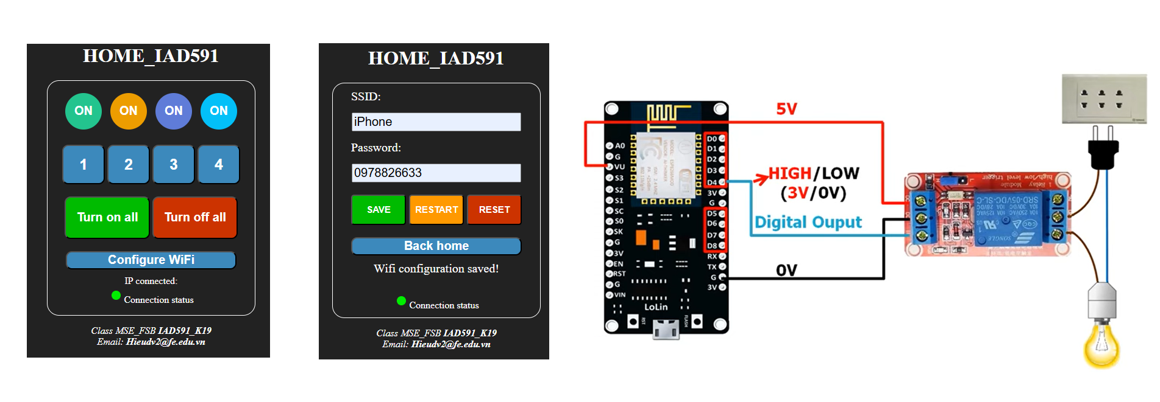
APPLICATION
https://www.youtube.com/watch?v=aoWAltuGFMg&t=0s
Notes:
#include <ESP8266WiFi.h>
#include <ESP8266WebServer.h>
#include <EEPROM.h>
ESP8266WebServer webServer(80);
//==========AP info=======================//
char* ssid_ap = "HOME_IAD591";
char* pass_ap = "12345678";
IPAddress ip_ap(192,168,1,1);
IPAddress gateway_ap(192,168,1,1);
IPAddress subnet_ap(255,255,255,0);
String statusD1="1",statusD2="1",statusD3="1",statusD4="1";
String ssid;
String pass;
//=========Biến chứa mã HTLM Website==//
const char MainPage[] PROGMEM = R"=====(
<!DOCTYPE html>
<html>
<head>
<title>HOME_IAD591</title>
<style>
body {text-align:center;background-color:#222222; color:white}
input {
height:25px;
width:270px;
font-size:20px;
margin: 10px auto;
}
#content {
border: white solid 1px;
padding:5px;
height:375px;
width:330px;
border-radius:20px;
margin: 0 auto
}
.ledstatus{
outline: none;
margin: 15px 5px;
width: 60px;
height: 60px;
border-radius: 50%;
-moz-border-radius: 50%;
-webkit-border-radius: 50%;
color:white;
font-size:20px;
font-weight: bold;
}
#ledstatus1{
border: solid 2px #23C48E;
background: #23C48E;
}
#ledstatus2{
border: solid 2px #ED9D00;
background: #ED9D00;
}
#ledstatus3{
border: solid 2px #5F7CD8;
background: #5F7CD8;
}
#ledstatus4{
border: solid 2px #03C0F8;
background: #03C0F8;
}
#ledconnect{
outline: none;
margin: 0px 5px -1px 5px;
width: 15px;
height: 15px;
border: solid 1px #00EE00;
background-color: #00EE00;
border-radius: 50%;
-moz-border-radius: 50%;
-webkit-border-radius: 50%;
}
.button {
height:65px;
width:70px;
margin:10px 0;
background-color:#3C89BC;
border-radius:10px;
outline:none;
color:white;
font-size:25px;
font-weight: bold;
}
.button_all{
height:70px;
width:140px;
margin:10px 0;
outline:none;
color:white;
font-size:20px;
font-weight: bold;
}
#button_on {
background-color:#00BB00;
border-radius:10px;
}
#button_off {
background-color:#CC3300;
border-radius:10px;
}
.button_setup {
height:30px;
width:280px;
margin:10px 0;
background-color:#3C89BC;
border-radius:10px;
outline:none;
color:white;
font-size:20px;
font-weight: bold;
}
.button_wifi{
height:50px;
width:90px;
margin:10px 0;
outline:none;
color:white;
font-size:15px;
font-weight: bold;
}
#button_save {
background-color:#00BB00;
border-radius:5px;
}
#button_restart {
background-color:#FF9900;
border-radius:5px;
}
#button_reset {
background-color:#CC3300;
border-radius:5px;
}
</style>
<meta name="viewport" content="width=device-width,user-scalable=0" charset="UTF-8">
</head>
<body>
<div><h1>HOME_IAD591</h1></div>
<div id="content">
<div id="homecontrol" style="height:340px";>
<div>
<input id="ledstatus1" class="ledstatus" type="button" value="ON"/>
<input id="ledstatus2" class="ledstatus" type="button" value="ON"/>
<input id="ledstatus3" class="ledstatus" type="button" value="ON"/>
<input id="ledstatus4" class="ledstatus" type="button" value="ON"/>
</div>
<div>
<button class="button" onclick=getbutton(1)>1</button>
<button class="button" onclick=getbutton(2)>2</button>
<button class="button" onclick=getbutton(3)>3</button>
<button class="button" onclick=getbutton(4)>4</button>
</div>
<div>
<button id="button_on" class="button_all" onclick="getbuttonall('on')">Turn on all</button>
<button id="button_off" class="button_all"onclick="getbuttonall('off')">Turn off all</button>
</div>
<div><input class="button_setup" type="button" onclick="configurewifi()" value="Configure WiFi"/></div>
<div>IP connected: <b><pan id="ipconnected"></pan></b></div>
</div>
<div id="wifisetup" style="height:340px; font-size:20px; display:none";>
<div style="text-align:left; width:270px; margin:5px 25px">SSID: </div>
<div><input id="ssid"/></div>
<div style="text-align:left; width:270px; margin:5px 25px">Password: </div>
<div><input id="pass"/></div>
<div>
<button id="button_save" class="button_wifi" onclick="writeEEPROM()">SAVE</button>
<button id="button_restart" class="button_wifi" onclick="restartESP()">RESTART</button>
<button id="button_reset" class="button_wifi" onclick="clearEEPROM()">RESET</button>
</div>
<div><input class="button_setup" type="button" onclick="backHOME()" value="Back home"/></div>
<div id="reponsetext"></div>
</div>
<div><input id="ledconnect" type="button"/>Connection status</div>
</div>
<div id="footer">
<p><i>Class MSE_FSB <b>IAD591_K19</b>
<br>Email: <b>Hieudv2@fe.edu.vn</b></i>
</p>
</div>
<script>
//-----------Hàm khởi tạo đối tượng request----------------
function create_obj(){
td = navigator.appName;
if(td == "Microsoft Internet Explorer"){
obj = new ActiveXObject("Microsoft.XMLHTTP");
}else{
obj = new XMLHttpRequest();
}
return obj;
}
//------------Khởi tạo biến toàn cục-----------------------------
var xhttp = create_obj();//Đối tượng request cho setup wifi
var xhttp_statusD = create_obj();//Đối tượng request cho cập nhật trạng thái
var d1,d2,d3,d4;
var ledconnect = 1;
//===================Khởi tạo ban đầu khi load trang=============
window.onload = function(){
document.getElementById("homecontrol").style.display = "block";
document.getElementById("wifisetup").style.display = "none";
getIPconnect();//Gửi yêu cầu lấy IP kết nối
getstatusD();//Gửi yêu cầu lấy trạng thái các chân điều khiển
}
//===================IPconnect====================================
//--------Tạo request lấy địa chỉ IP kết nối----------------------
function getIPconnect(){
xhttp.open("GET","/getIP",true);
xhttp.onreadystatechange = process_ip;//nhận reponse
xhttp.send();
}
//-----------Kiểm tra response IP và hiển thị------------------
function process_ip(){
if(xhttp.readyState == 4 && xhttp.status == 200){
//------Updat data sử dụng javascript----------
ketqua = xhttp.responseText;
document.getElementById("ipconnected").innerHTML=ketqua;
}
}
//===========Cập nhật trạng thái Led===============================
//-----------Gửi yêu cầu lấy trạng thái các chân D-----------------
function getstatusD(){
xhttp_statusD.open("GET","/getSTATUSD",true);
xhttp_statusD.onreadystatechange = process_statusD;
xhttp_statusD.send();
}
//-----------Kiểm tra và nhận response EEPROM----------------------
function process_statusD(){
if(xhttp_statusD.readyState == 4 && xhttp_statusD.status == 200){
if(ledconnect == 1){
ledconnect = 0;
document.getElementById("ledconnect").style.background = "#222222";
}else{
ledconnect = 1;
document.getElementById("ledconnect").style.background = "#00EE00";
}
//------Update trạng thái led tín hiệu lên panel điều khiển----
var statusD = xhttp_statusD.responseText;
var obj = JSON.parse(statusD);
d1 = obj.D1;
d2 = obj.D2;
d3 = obj.D3;
d4 = obj.D4;
updateLedstatus(d1,d2,d3,d4);
}
}
//----------Hiển thị trạng thái Led lên trình duyệt---------------------
function updateLedstatus(D1,D2,D3,D4){
if(D1 == "1"){
document.getElementById("ledstatus1").value = "OFF";
document.getElementById("ledstatus1").style.background = "#222222";
}else{
document.getElementById("ledstatus1").value = "ON";
document.getElementById("ledstatus1").style.background = "#23C48E";
}
if(D2 == "1"){
document.getElementById("ledstatus2").value = "OFF";
document.getElementById("ledstatus2").style.background = "#222222";
}else{
document.getElementById("ledstatus2").value = "ON";
document.getElementById("ledstatus2").style.background = "#ED9D00";
}
if(D3 == "1"){
document.getElementById("ledstatus3").value = "OFF";
document.getElementById("ledstatus3").style.background = "#222222";
}else{
document.getElementById("ledstatus3").value = "ON";
document.getElementById("ledstatus3").style.background = "#5F7CD8";
}
if(D4 == "1"){
document.getElementById("ledstatus4").value = "OFF";
document.getElementById("ledstatus4").style.background = "#222222";
}else{
document.getElementById("ledstatus4").value = "ON";
document.getElementById("ledstatus4").style.background = "#03C0F8";
}
}
//===========Tạo và gửi request khi ấn button============================
//-----------Thiết lập dữ liệu và gửi request ON/OFF D4---
function getbutton(n){
switch (n){
case 1:
var ledstatus1 = document.getElementById("ledstatus1").value;
if(ledstatus1 == "ON"){
xhttp_statusD.open("GET","/D1off",true);
}else{
xhttp_statusD.open("GET","/D1on",true);
}
xhttp_statusD.onreadystatechange = process_statusD;
xhttp_statusD.send();
break;
case 2:
var ledstatus2 = document.getElementById("ledstatus2").value;
if(ledstatus2 == "ON"){
xhttp_statusD.open("GET","/D2off",true);
}else{
xhttp_statusD.open("GET","/D2on",true);
}
xhttp_statusD.onreadystatechange = process_statusD;
xhttp_statusD.send();
break;
case 3:
var ledstatus3 = document.getElementById("ledstatus3").value;
if(ledstatus3 == "ON"){
xhttp_statusD.open("GET","/D3off",true);
}else{
xhttp_statusD.open("GET","/D3on",true);
}
xhttp_statusD.onreadystatechange = process_statusD;
xhttp_statusD.send();
break;
case 4:
var ledstatus4 = document.getElementById("ledstatus4").value;
if(ledstatus4 == "ON"){
xhttp_statusD.open("GET","/D4off",true);
}else{
xhttp_statusD.open("GET","/D4on",true);
}
xhttp_statusD.onreadystatechange = process_statusD;
xhttp_statusD.send();
break;
}
}
function getbuttonall(m){
if(m == "on"){
xhttp_statusD.open("GET","/Allon",true);
}else if(m=="off"){
xhttp_statusD.open("GET","/Alloff",true);
}
xhttp_statusD.onreadystatechange = process_statusD;
xhttp_statusD.send();
}
//===========Configure WiFi=====================================
function configurewifi(){
document.getElementById("homecontrol").style.display = "none";
document.getElementById("wifisetup").style.display = "block";
}
//-----------Thiết lập dữ liệu và gửi request ssid và password---
function writeEEPROM(){
if(Empty(document.getElementById("ssid"), "Please enter ssid!")&&Empty(document.getElementById("pass"), "Please enter password")){
var ssid = document.getElementById("ssid").value;
var pass = document.getElementById("pass").value;
xhttp.open("GET","/writeEEPROM?ssid="+ssid+"&pass="+pass,true);
xhttp.onreadystatechange = process;//nhận reponse
xhttp.send();
}
}
function clearEEPROM(){
if(confirm("Do you want to delete all saved wifi configurations?")){
xhttp.open("GET","/clearEEPROM",true);
xhttp.onreadystatechange = process;//nhận reponse
xhttp.send();
}
}
function restartESP(){
if(confirm("Do you want to reboot the device?")){
xhttp.open("GET","/restartESP",true);
xhttp.send();
alert("Device is restarting! If no wifi is found please press reset!");
}
}
//-----------Kiểm tra response -------------------------------------------
function process(){
if(xhttp.readyState == 4 && xhttp.status == 200){
//------Updat data sử dụng javascript----------
ketqua = xhttp.responseText;
document.getElementById("reponsetext").innerHTML=ketqua;
}
}
//============Hàm thực hiện chứ năng khác================================
//--------Cập nhật trạng thái tự động sau 2000 giây----------------------
setInterval(function() {
getstatusD();
},2000);
//--------Load lại trang để quay về Home control-------------------------
function backHOME(){
window.onload();
}
//----------------------------CHECK EMPTY--------------------------------
function Empty(element, AlertMessage){
if(element.value.trim()== ""){
alert(AlertMessage);
element.focus();
return false;
}else{
return true;
}
}
//------------------------------------------------------------------------
</script>
</body>
</html>
)=====";
//=========================================//
void setup() {
Serial.begin(9600);
pinMode(D1,OUTPUT);
pinMode(D2,OUTPUT);
pinMode(D3,OUTPUT);
pinMode(D4,OUTPUT);
digitalWrite(D1,HIGH);
digitalWrite(D2,HIGH);
digitalWrite(D3,HIGH);
digitalWrite(D4,HIGH);
EEPROM.begin(512); //Khởi tạo bộ nhớ EEPROM
delay(10);
if(read_EEPROM()){
checkConnection();
}else{
WiFi.disconnect();
WiFi.mode(WIFI_AP);
WiFi.softAPConfig(ip_ap, gateway_ap, subnet_ap);
WiFi.softAP(ssid_ap,pass_ap,1,false);
Serial.println("Soft Access Point mode!");
Serial.print("Please connect to");
Serial.println(ssid_ap);
Serial.print("Web Server IP Address: ");
Serial.println(ip_ap);
}
webServer.on("/",mainpage);
webServer.on("/getSTATUSD",get_STATUSD);
webServer.on("/D1on",D1_on);
webServer.on("/D1off",D1_off);
webServer.on("/D2on",D2_on);
webServer.on("/D2off",D2_off);
webServer.on("/D3on",D3_on);
webServer.on("/D3off",D3_off);
webServer.on("/D4on",D4_on);
webServer.on("/D4off",D4_off);
webServer.on("/Allon",All_on);
webServer.on("/Alloff",All_off);
webServer.on("/getIP",get_IP);
webServer.on("/writeEEPROM",write_EEPROM);
webServer.on("/restartESP",restart_ESP);
webServer.on("/clearEEPROM",clear_EEPROM);
webServer.begin();
}
void loop() {
webServer.handleClient();
}
//==========Chương trình con=================//
void mainpage(){
String s = FPSTR(MainPage);
webServer.send(200,"text/html",s);
}
void get_STATUSD(){
if(digitalRead(D1)==0){
statusD1 = "0";
}else{
statusD1 = "1";
}
if(digitalRead(D2)==0){
statusD2 = "0";
}else{
statusD2 = "1";
}
if(digitalRead(D3)==0){
statusD3 = "0";
}else{
statusD3 = "1";
}
if(digitalRead(D4)==0){
statusD4 = "0";
}else{
statusD4 = "1";
}
String s = "{\"D1\": \""+ statusD1 +"\"," +
"\"D2\": \""+ statusD2 + "\"," +
"\"D3\": \""+ statusD3 + "\"," +
"\"D4\": \""+ statusD4 +"\"}";
webServer.send(200,"application/json",s);
}
//--------------Điều khiển chân D1----------------
void D1_on(){
digitalWrite(D1,LOW);
get_STATUSD();
}
void D1_off(){
digitalWrite(D1,HIGH);
get_STATUSD();
}
//--------------Điều khiển chân D2----------------
void D2_on(){
digitalWrite(D2,LOW);
get_STATUSD();
}
void D2_off(){
digitalWrite(D2,HIGH);
get_STATUSD();
}
//--------------Điều khiển chân D3----------------
void D3_on(){
digitalWrite(D3,LOW);
get_STATUSD();
}
void D3_off(){
digitalWrite(D3,HIGH);
get_STATUSD();
}
//--------------Điều khiển chân D4----------------
void D4_on(){
digitalWrite(D4,LOW);
get_STATUSD();
}
void D4_off(){
digitalWrite(D4,HIGH);
get_STATUSD();
}
//--------------Điều khiển chân D----------------
void All_on(){
digitalWrite(D1,LOW);
digitalWrite(D2,LOW);
digitalWrite(D3,LOW);
digitalWrite(D4,LOW);
get_STATUSD();
}
void All_off(){
digitalWrite(D1,HIGH);
digitalWrite(D2,HIGH);
digitalWrite(D3,HIGH);
digitalWrite(D4,HIGH);
get_STATUSD();
}
void get_IP(){
String s = WiFi.localIP().toString();
webServer.send(200,"text/html", s);
}
boolean read_EEPROM(){
Serial.println("Reading EEPROM...");
if(EEPROM.read(0)!=0){
ssid = "";
pass = "";
for (int i=0; i<32; ++i){
ssid += char(EEPROM.read(i));
}
Serial.print("SSID: ");
Serial.println(ssid);
for (int i=32; i<96; ++i){
pass += char(EEPROM.read(i));
}
Serial.print("PASSWORD: ");
Serial.println(pass);
ssid = ssid.c_str();
pass = pass.c_str();
return true;
}else{
Serial.println("Data wifi not found!");
return false;
}
}
//---------------SETUP WIFI------------------------------
void checkConnection() {
Serial.println();
WiFi.disconnect();
WiFi.mode(WIFI_STA);
Serial.print("Check connecting to ");
Serial.println(ssid);
WiFi.begin(ssid,pass);
int count=0;
while(count < 50){
if(WiFi.status() == WL_CONNECTED){
Serial.println();
Serial.print("Connected to ");
Serial.println(ssid);
Serial.print("Web Server IP Address: ");
Serial.println(WiFi.localIP());
return;
}
delay(200);
Serial.print(".");
count++;
}
Serial.println("Timed out.");
WiFi.disconnect();
WiFi.mode(WIFI_AP);
WiFi.softAPConfig(ip_ap, gateway_ap, subnet_ap);
WiFi.softAP(ssid_ap,pass_ap,1,false);
Serial.println("Soft Access Point mode!");
Serial.print("Please connect to");
Serial.println(ssid_ap);
Serial.print("Web Server IP Address: ");
Serial.println(ip_ap);
}
void write_EEPROM(){
ssid = webServer.arg("ssid");
pass = webServer.arg("pass");
Serial.println("Clear EEPROM!");
for (int i = 0; i < 96; ++i) {
EEPROM.write(i, 0);
delay(10);
}
for (int i = 0; i < ssid.length(); ++i) {
EEPROM.write(i, ssid[i]);
}
for (int i = 0; i < pass.length(); ++i) {
EEPROM.write(32 + i, pass[i]);
}
EEPROM.commit();
Serial.println("Writed to EEPROM!");
Serial.print("SSID: ");
Serial.println(ssid);
Serial.print("PASS: ");
Serial.println(pass);
String s = "Wifi configuration saved!";
webServer.send(200, "text/html", s);
}
void restart_ESP(){
ESP.restart();
}
void clear_EEPROM(){
Serial.println("Clear EEPROM!");
for (int i = 0; i < 512; ++i) {
EEPROM.write(i, 0);
delay(10);
}
EEPROM.commit();
String s = "Device has been reset!";
webServer.send(200,"text/html", s);
}

Slide 33
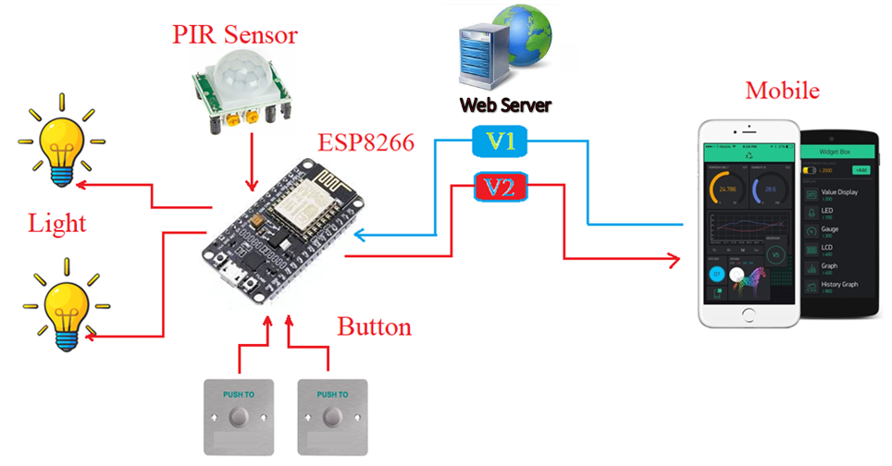
SMART SYSTEM

Slide 34
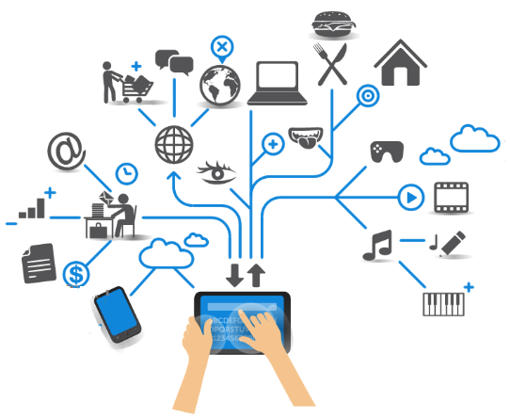
THANK YOU

